Slide 1
English Phoneme Recognition of Korean Children using Self-Supervised Learning based Domain Adaptation
Ji-Eun Park
English Linguistics

Slide 2
Index
1. Introduction
2. Conventional Studies
3. Methodology
4. Experimental Setups
5. Results and Discussion
6. Conclusion

Slide 3
Introduction
Research Subject
English phoneme recognition of Korean children
Utilizing domain adaptation based on Self-Supervised Learning (SSL)
Motivation of Research
Importance in the field of education for pronunciation correcting system
Scarcity of non-native children labeled data
Insufficient research in non-native children phoneme recognition
Goal of the study
The present study aims to construct an advanced phoneme recognition model for Korean children speaking English words by applying domain adaptation in SSL.

Slide 4
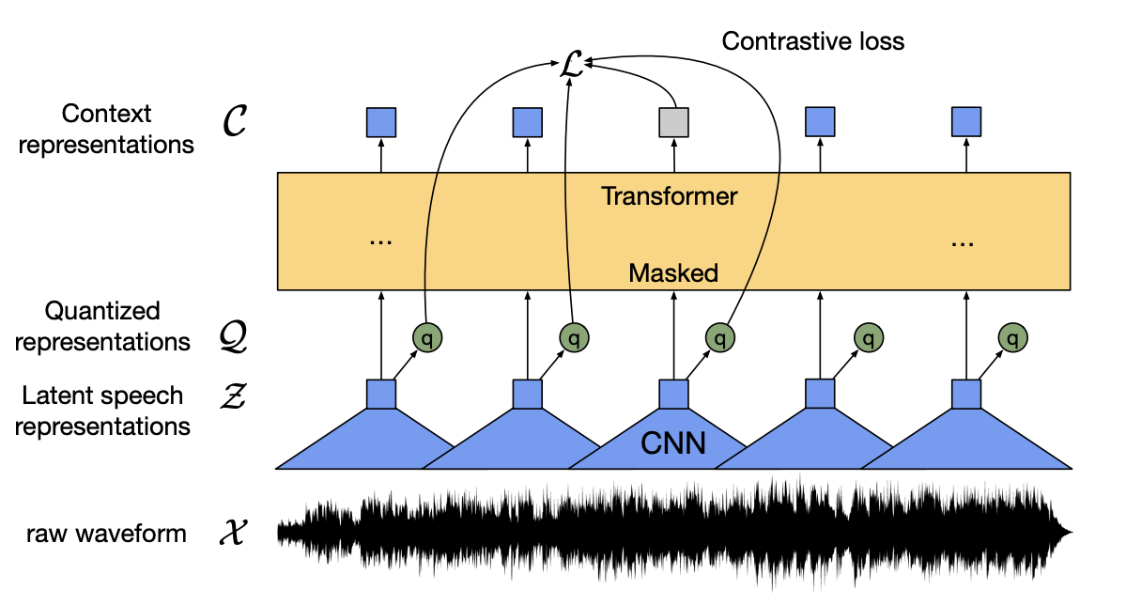
Conventional Studies
Self-supervised Learning (SSL)
A paradigm training a representation on a large scale of unlabeled data, then fine-tuning on a small amount of annotated data
In the speech field, widely using the Wav2Vec2 pre-trained model [1]
In this work, using Wav2Vec2 to overcome the small amount of available labeled data
Native English adult speech used for pre-training data, Korean children speech used for fine-tuning data
Context Module
Quantization Module
Feature Encoder
Input
Figure 1. The overall structure of Wav2Vec2 [1]
Baevski, A., Zhou, Y., Mohamed, A., & Auli, M. (2020). wav2vec 2.0: A framework for self-supervised learning of speech representations. Advances in neural information processing systems, 33, 12449-12460.

Slide 5
Conventional Studies
Domain adaptation
Transferring knowledge source → target where the data distributions differ
e.g., Adapter-based, Feature augmentation, Adversarial training, etc.
Domain shift problem in SSL
Significant different distribution between the domain of pre-training data (source domain) and fine-tuning data (target domain)
Performance degradation on target domain
Cannot generalize data distribution across different domains
Addressing the domain shift problem in SSL
For non-native Automatic Speech Recognition (ASR) in SSL [2]
Residual Adapters (RAs) into the end of every encoder block
Learning domain-related information, leading to better adapt to the target domain
Expected effect
The generalized distribution of speech representation between the native English adult domain and the Korean children domain
[2] Fan, R., & Alwan, A. (2022). DRAFT: A novel framework to reduce domain shifting in self-supervised learning and its application to children's ASR.

Slide 6
Methodology
Preliminaries
Employing a speaker adaptation framework proposed for dysarthric ASR [3]
Similarity in characteristics of speech between dysarthric domain and non-native child domain
Limited number of speech data
Domain mismatch between pre-training and fine-tuning data
Causing domain shift problem due to the significant difference in phonetic aspects with normal speech
Intra-speaker, inter-speaker variability exist
→ To address variabilities, incorporating adapters with the fMLLR feature and x-vector as speaker adaptive features
Necessity to modify the feature and the framework
Modifying the adaptive feature due to the difference in research goal
Insufficient number of parameters in the fine-tuning stage for adaptation, thereby enhancing the level of domain adaptation
[3] Baskar, M. K., Herzig, T., Nguyen, D., Diez, M., Polzehl, T., Burget, L., & Černocký, J. (2022). Speaker adaptation for Wav2vec2 based dysarthric ASR.

Slide 7
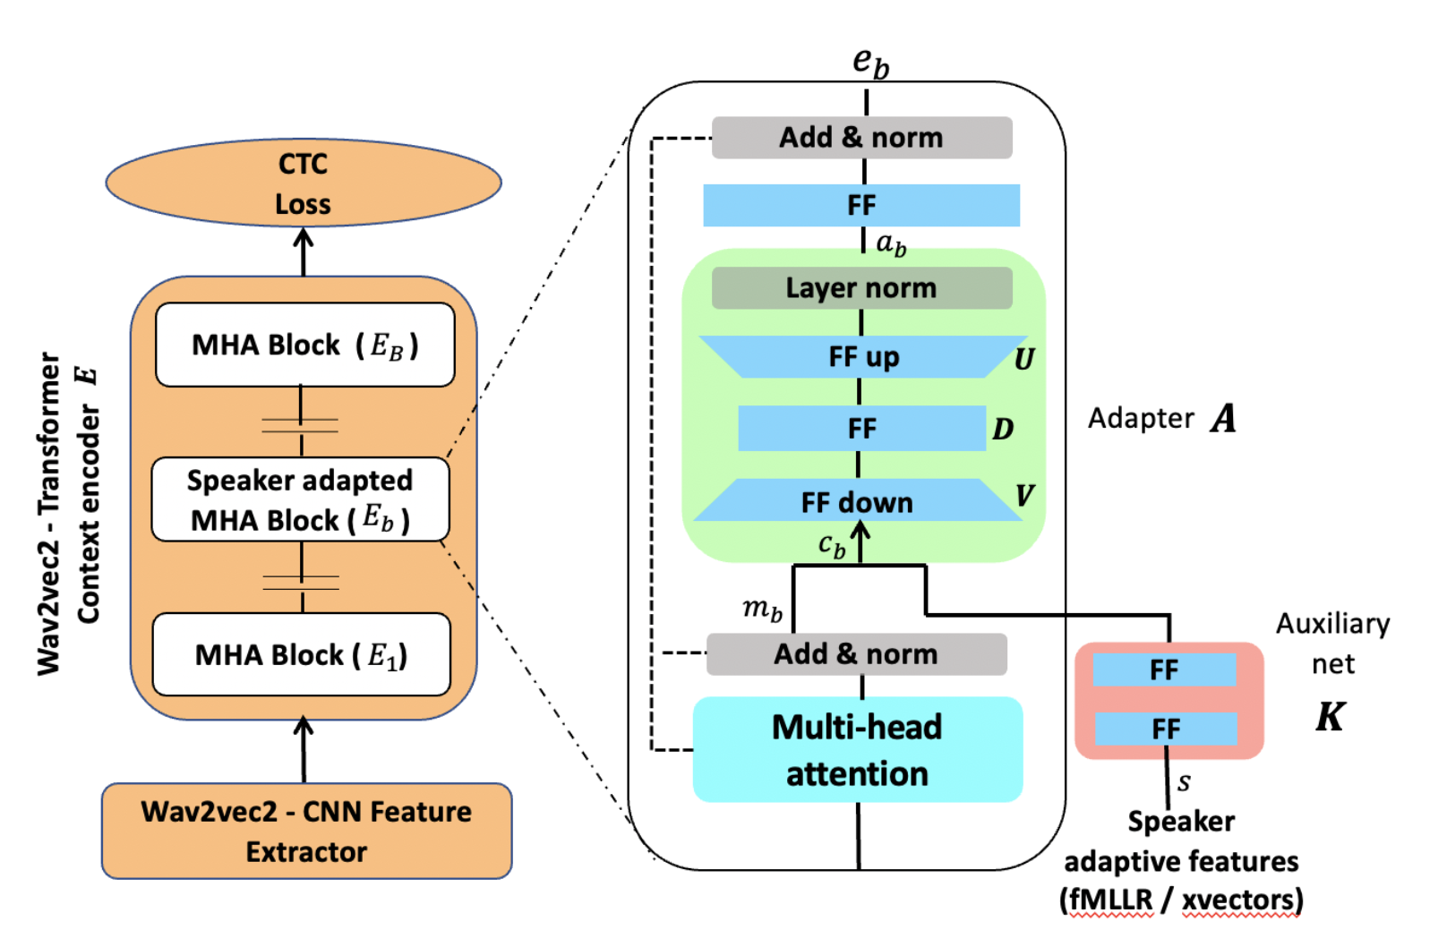
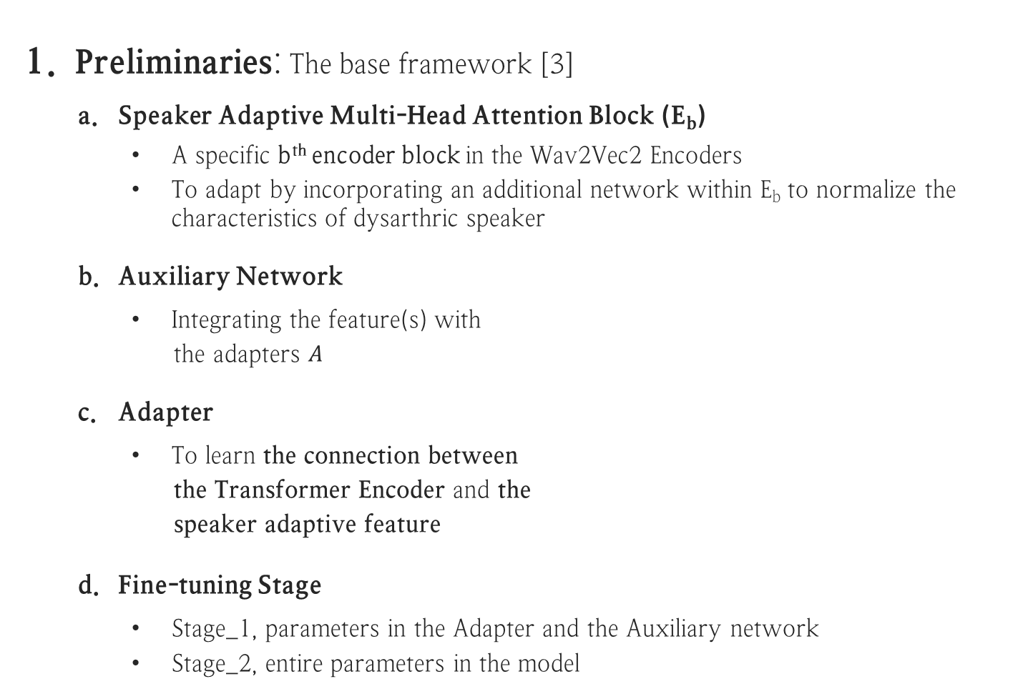
Methodology
Preliminaries: The base framework [3]
Speaker Adaptive Multi-Head Attention Block (E_{b})
A specific b^{th} encoder block in the Wav2Vec2 Encoders
To adapt by incorporating an additional network within E_{b} to normalize the characteristics of dysarthric speaker
Auxiliary Network
Integrating the feature(s) with
the adapters $A$
Adapter
To learn the connection between
the Transformer Encoder and the
speaker adaptive feature
Fine-tuning Stage
Stage_1, parameters in the Adapter and the Auxiliary network
Stage_2, entire parameters in the model
Figure 2. The overall model structure of
dysarthric ASR [2]

Slide 8
Methodology - the proposed approach
The proficiency-dependent fMLLR feature
In the previous study [3]
Speaker-dependent fMLLR feature
To normalize the variabilities between specific speakers for speaker adaptation
In the present study
Rather than focusing on specific speakers, we aim to construct a model for general purpose.
Proficiency-dependent fMLLR feature for domain adaptation
Normalizing inter-speaker variability within the proficiency levels
Reducing the individual characteristics in a speech of Korean children, increasing general characteristics of each proficiency level
Expected effect
Mitigating the differences in distribution of speech representations between native English speakers and Korean child speakers

Slide 9
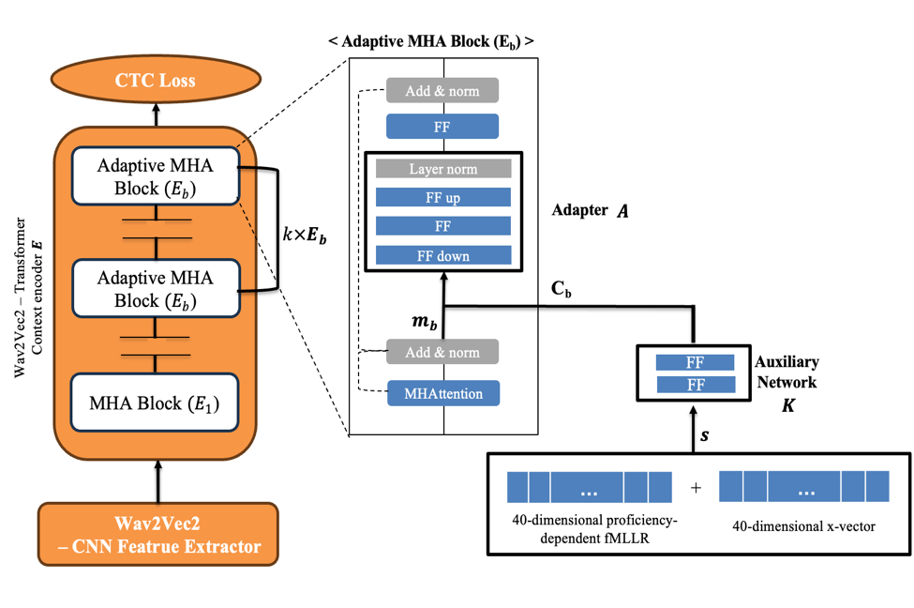
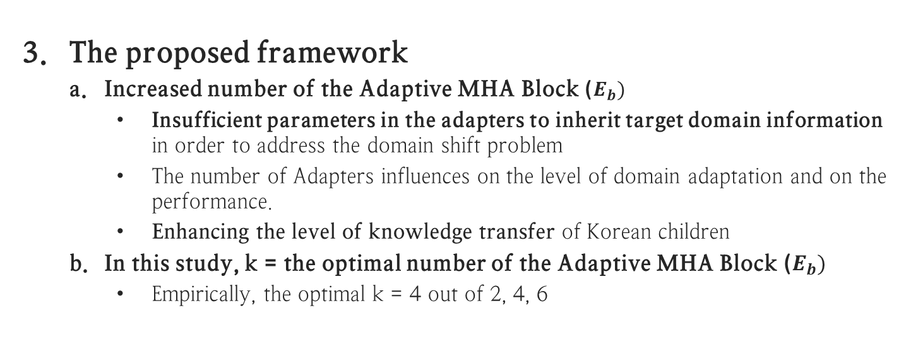
Methodology - the proposed approach
The proposed framework
Increased number of the Adaptive MHA Block ($E_{b})$
Insufficient parameters in the adapters to inherit target domain information in order to address the domain shift problem
The number of Adapters influences on the level of domain adaptation and on the performance.
Enhancing the level of knowledge transfer of Korean children
In this study, k = the optimal number of the Adaptive MHA Block ($E_{b})$
Empirically, the optimal k = 4 out of 2, 4, 6
Figure 3. The structure of the proposed framework
Notes:
K-an optimal number of adaptive MHA blocks
Target data의 수를 고려한 optimal block 수

Slide 10
Experimental Setups
Dataset
Korean-Spoken English Corpus (K-SEC)
Including English isolated words spoken by elementary school students
443 of unique English words, the total 15k wavfiles (5h)
Three proficiency levels (advanced, intermediate, novice)
For reliability, conducting 3 experiments with different speakers
Labeling - Tokenization with 43 IPA including Pad (blank), unknown, word delimiter(|)
Training Models
Baseline - Training data at all the proficiency levels (SUM) within each ExpSet
Proposed model
Stage_1 – Training data by each proficiency level (Adv, Int, Nov) within each ExpSet
Stage_2 – Training data at all the proficiency levels (SUM) within each ExpSet
 | Train |  |  |  | Test
 | Adv (2 spks) | Int (2 spks) | Nov (2 spks) | SUM (6 spks) | Adv (1 spk) | Int (1 spk) | Nov (1 spk) | SUM (3 spks)
ExpSet_1 | 706 | 700 | 702 | 2108 | 360 | 360 | 360 | 1080
ExpSet_2 | 716 | 700 | 716 | 2132 | 350 | 310 | 341 | 1001
ExpSet_3 | 710 | 696 | 710 | 2116 | 356 | 333 | 336 | 1025
Table 1. The number of speakers and wavfiles in each experimental set (ExpSet)
(Data of different speakers used in each ExpSet)

Slide 11
Experimental Setups
Pre-trained Model
Wav2Vec2-LARGE-ROBUST pre-trained on 96k data
Librispeech-light, Commonvoice, Fisher, Switchboard (native English adult)
Training Configuration
Hugging Face Trainer
Batch size=8, Epoch=50, Learning rate=1e-4, Warmup steps=500
Adaptive Feature Extraction
Proficiency-dependent fMLLR
Recipe from Kaldi
Generating the 40-dimensional fMLLR feature
x-vector
Using Wav2Vec2ForXvector as an extractor
Generating the 512, 20, 40-dimensional x-vectors

Slide 12
Results and Discussion
(Phoneme Error Rate %)
Model | AVG | Proficiency Level
 |  | Advanced | Intermediate | Novice
FT (baseline) | 12.55 | 9.41 | 11.19 | 13.92
Proficiency-dependent fMLLR + FT | 11.67 | 7.60 | 13.13 | 14.33
40-dimensional x-vector + FT | 11.60 | 7.11 | 12.98 | 14.73
A single adaptive MHA Block +FT | 11.22 | 6.95 | 11.80 | 14.87
Multiple adaptive MHA Blocks + FT (proposed) | 10.84 | 6.96 | 11.67 | 13.87
The average %PER performed best in the model integrating the Multiple adaptive MHA blocks, PER 13.63% relative enhancement.
Compared with the baseline, PER 26.14%/0.36% improvement at the Advanced and Novice levels
Performance degradation at the Intermediate level
Due to the increased intra-speaker variability at the proposed framework compared to the baseline
Notes:
Multiple – k 기재

Slide 13
Conclusion
Summary of research
Improvement of phoneme recognition of Korean children by addressing the domain shift problem using domain adaptation
Proposed Approaches
Feature – Proficiency-dependent fMLLR to normalize inter-speaker variability
Framework – Increased the number of adapters to transfer knowledge of Korean children
Conclusion
The performance improvement indicates that the proposed feature is effectively integrated into the modified framework.
Addressing the domain shift problem by domain adaptation which incorporates the feature and enhances transfer knowledge of Korean children
Generalized speech representation between English native speakers and Korean child speakers
Future Research
Applying the proposed framework to Wav2Vec2-Conformer

Slide 14
Thank you

Slide 15
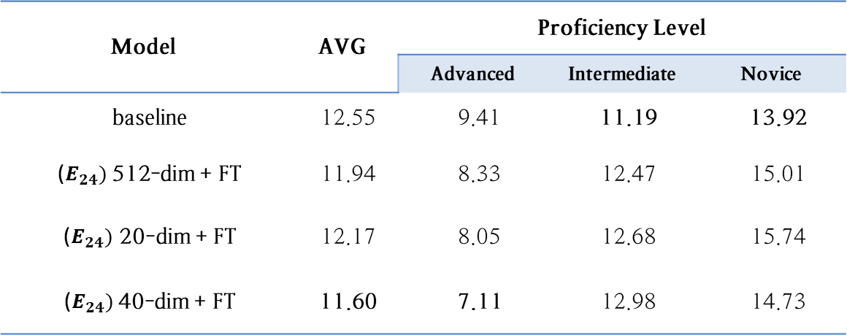
Appendix (1)
(PER%)
Model | AVG | Proficiency Level
 |  | Advanced | Intermediate | Novice
baseline | 12.55 | 9.41 | 11.19 | 13.92
($E_{24})$512-dim + FT | 11.94 | 8.33 | 12.47 | 15.01
($E_{24})$ 20-dim + FT | 12.17 | 8.05 | 12.68 | 15.74
($E_{24})$40-dim + FT | 11.60 | 7.11 | 12.98 | 14.73
The variance and PER (%) of the model implementing multiple adaptive MHA blocks
Notes:
Multiple – k 기재

Slide 16
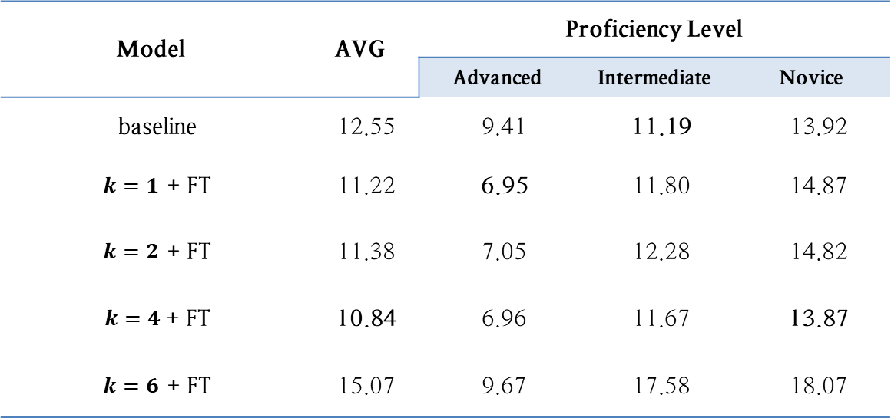
Appendix (2)
(PER%)
Model | AVG | Proficiency Level
 |  | Advanced | Intermediate | Novice
baseline | 12.55 | 9.41 | 11.19 | 13.92
$k=1$ + FT | 11.22 | 6.95 | 11.80 | 14.87
$k=2$ + FT | 11.38 | 7.05 | 12.28 | 14.82
$k=4$+ FT | 10.84 | 6.96 | 11.67 | 13.87
$k=6$ + FT | 15.07 | 9.67 | 17.58 | 18.07
The results of the proposed framework using the multiple MHA blocks (PER %)

Slide 17
Appendix (3)
Proficiency Level | Models (PER (%)) |  | _{Variance} _{Difference}
 | baseline | Concatenation in Multiple adaptive MHA Blocks + FT
Advanced | 9.41% | 6.96% | 0.0612
Intermediate | 11.19% | 11.67% | -0.085
Novice | 13.92% | 13.87% | 0.0618
The variance and PER (%) of the model implementing multiple adaptive MHA blocks
Notes:
Multiple – k 기재

Slide 18
Publication List
박지은, 박정식. (2024). 한국인 아동 화자의 수준별 영어 음소 인식을 위한 Wav2Vec2 기반의 도메인 적응 기법, 한국음성학회
우수 논문 발표상 수상
박지은, 박정식, 강병옥. (2023). 자기 지도 학습 기반의 도메인 적응 기법을 이용한 한국 아동 화자의 영어 음소 인식, 한국음성학회
경나, 박지은, 김규진, 박정식, 강병옥. (2022). HuBERT 기반 한국인 아동 발화 영어 음소 인식 연구, 한국음성학회

